Slide 1
LunchBytes 13 October 2021 What’s neat about using the MATLAB IDE
Fred Sonnenwald
Department of Civil & Structural Engineering
The University of Sheffield
Notes:
I use MATLAB primarily for research, but also some teaching, and this will be an overview of the parts of MATLAB I find useful.
I mentioned examples in the abstract, these will be conceptual, illustrating when I’ve used different MATLAB features.

Slide 2
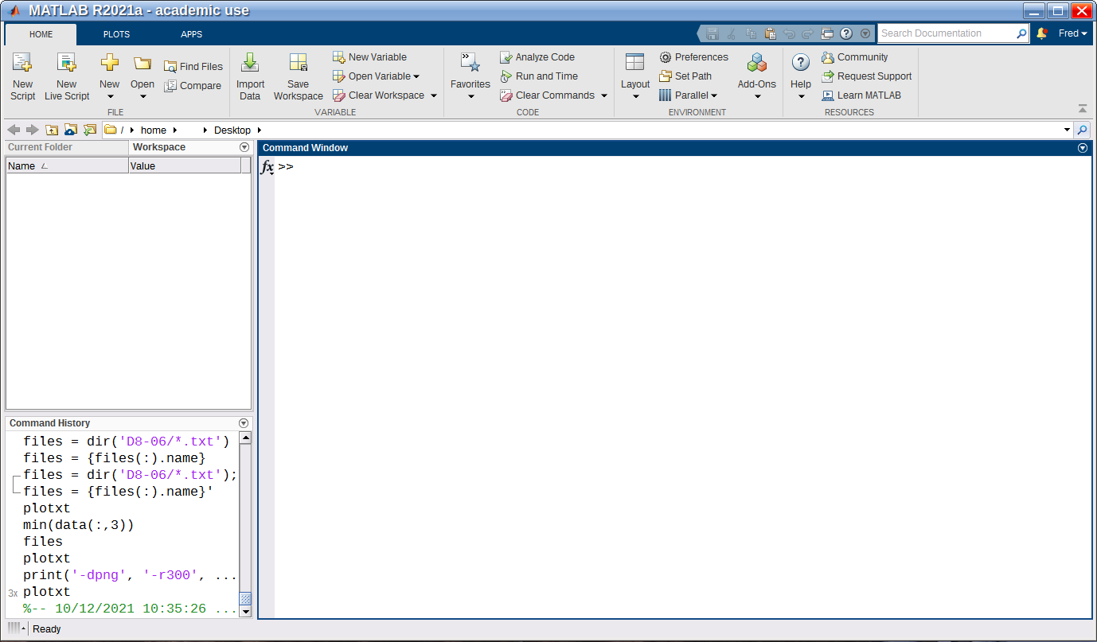
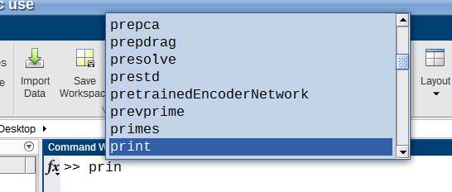
‘IDE’ – Integrated Development Environment
Editor
Profiler
Live scripts
List of variables
Command window
Debugger
Tab completion
Command History
Completion via up arrow
Notes:
MATLAB tightly integrates its command window, editor, debugger, profiler, and live scripts into an Integrated Development Environment (IDE) in a way uncommon for interpreted languages.
The main window also presents (as configured) all variables and the command history.

Slide 3
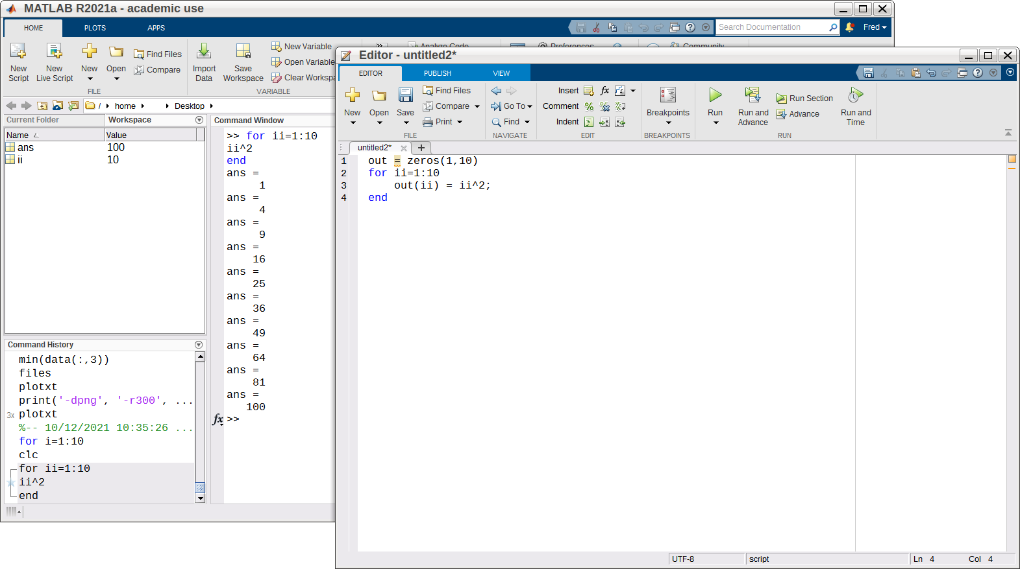
Editor
Regular file menu entries
Run
Code formatting
Copy & paste from history to the editor to get started on a script
Notes:
After you sort of wrap your head around the main window, the next most important thing is the editor.
Code written in the command window can be copy pated from the history into a script to get started writing. In general MATLAB is happy to be used for functional programming.
The editor is a regular text editing type interface, with some coding extras thrown in.
All of this is pretty standard.

Slide 4
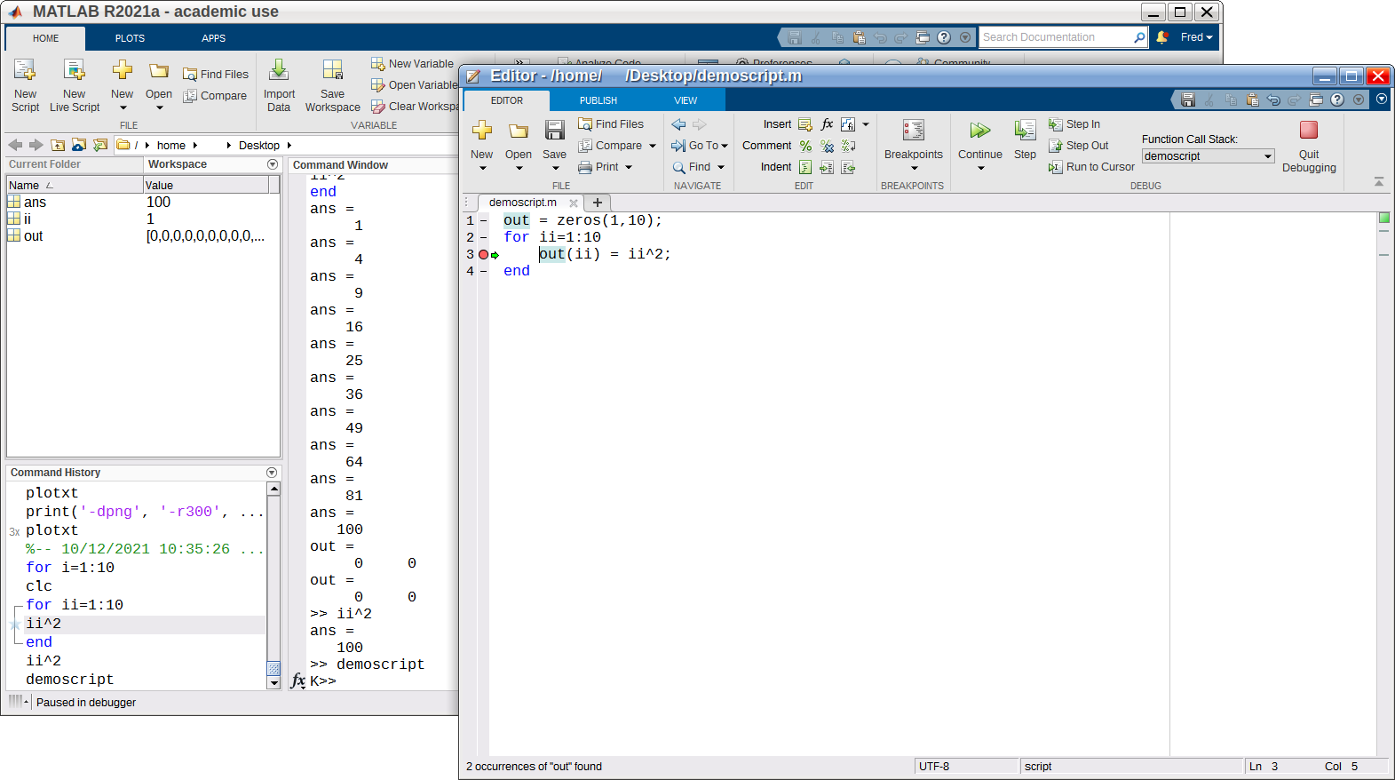
Debugging
When running, the script interrupts at the break point
The current values of all variables can be checked and edited
Click on a line to set a debugging breakpoint
The code can be continued, or stepped through line by line to check what’s happening
Interactive debugging can also be entered using the keyboard command, the dbcont command continues running the script
The workspace can be interacted with normally to use for debugging
Notes:
Debugging is the most powerful part of the IDE, the ability to set a breakpoint at a line of code and jump into the script to see the contents of all variables and try running bits of code interactively before continuing.
The ‘keyboard’ command was of great benefit when I was working on a looping optimisation routine and wanted to break only after several iterations.

Slide 5
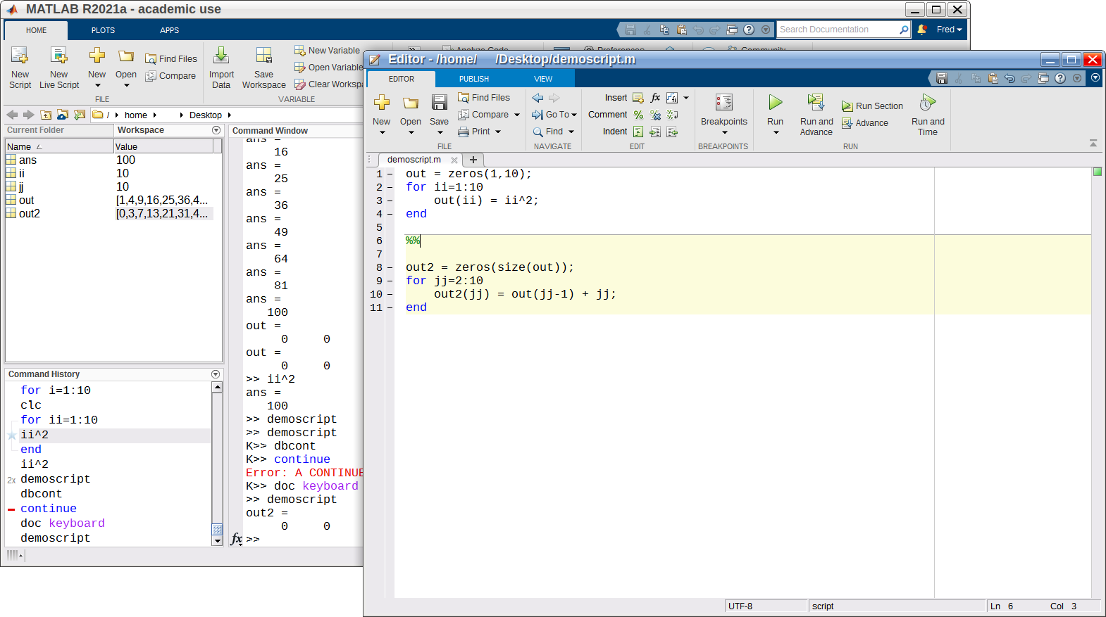
Sections
Use %% to demarcate a section
Each section can be run individually (UI button or alt-enter)
(Similarly, highlighted code can be run by pressing F9)
Sections can be used while debugging as well, or inside a for loop to trial iterations
Notes:
A useful feature of the editor are sections, blocks of code that can be run individually, much like a Jupyter notebook.
I often use sections when testing out data analysis or processing, running a section with that big of analysis. On Monday I was using this to develop how I wanted to format a plot.

Slide 6
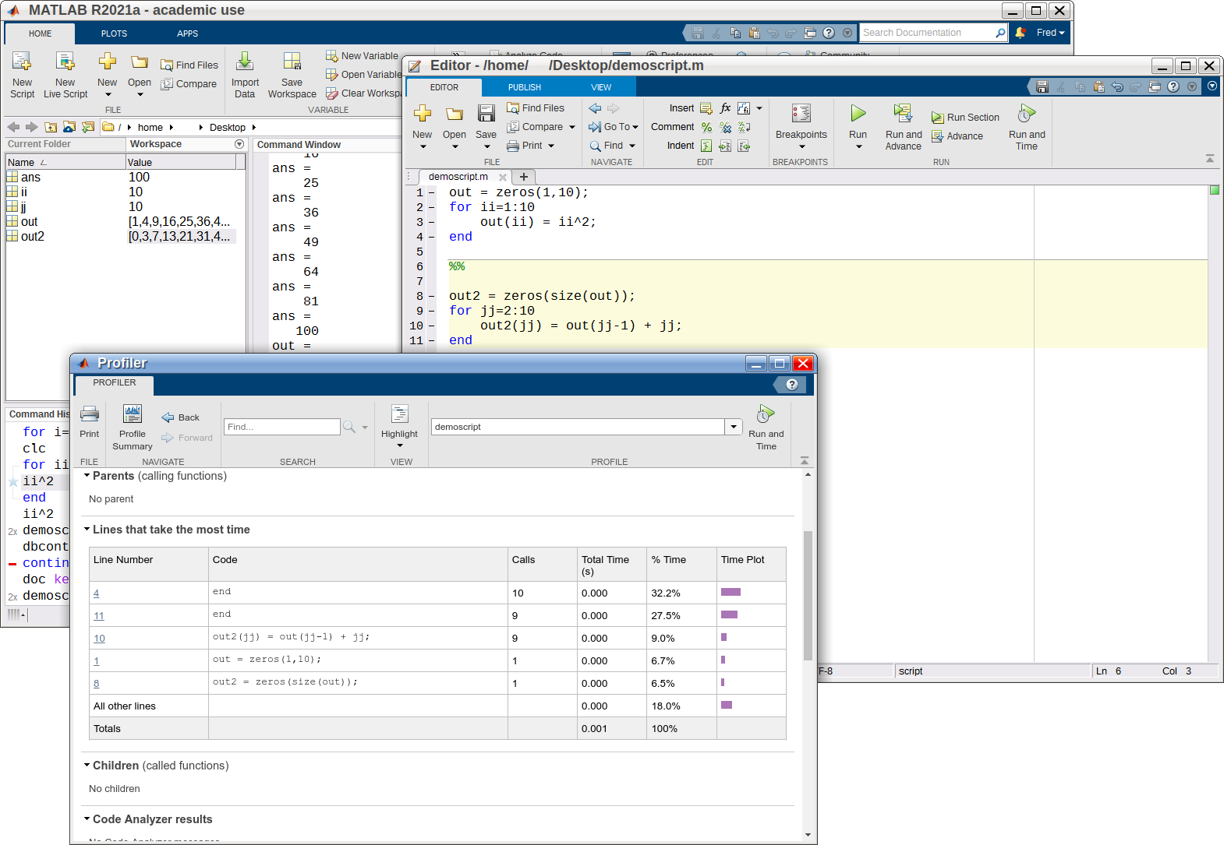
Profiling
Run and time runs the script through the profiler
A report is generated detailing the lines of code that consume the most CPU time
This first for loop is comparatively slow
Speed it up maybe?
Notes:
A really nice feature is the integration of the profiler, to time how long sections of code take to run.
I’ve found this is a great way to help highlight where to investigate vectorisation.

Slide 7
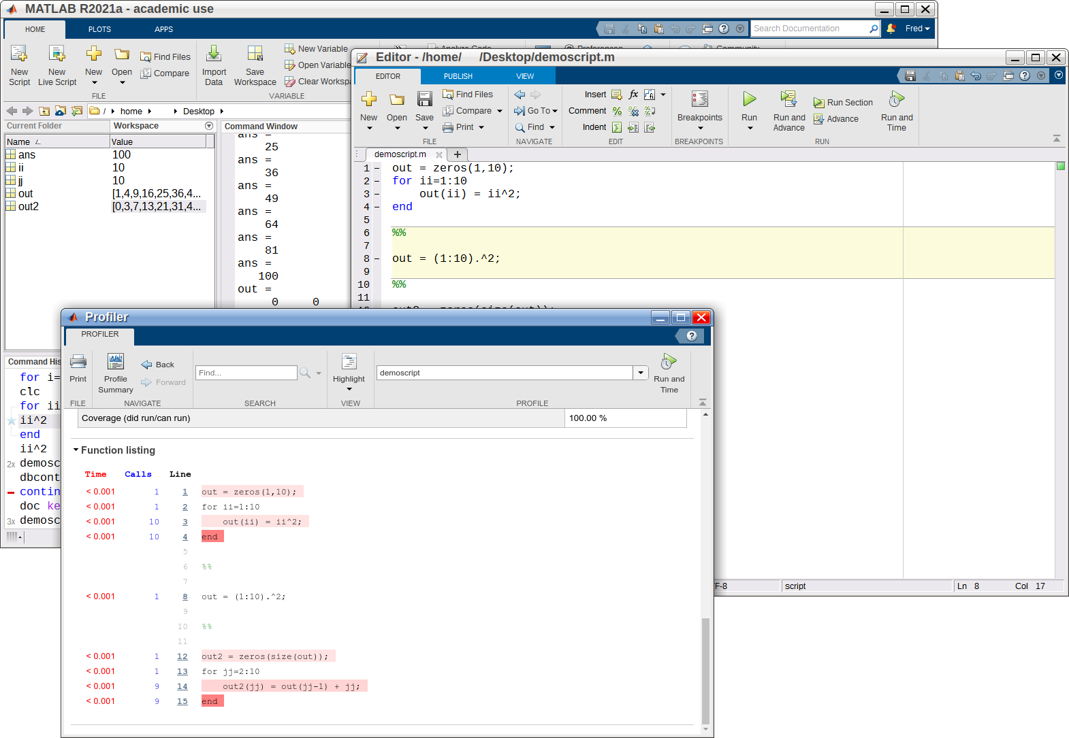
Profiling
Vectorised version of the first for loop
(Changing the size of out to 1 million elements shows the vectorised version to be about 10x faster)
According to the profiler report this does execute a bit faster
Notes:
I used the profiler and the vectorisation approach to speed up my Advection Dispersion Equation solution, a piece of code I have since executed thousands if not millions of times.

Slide 8
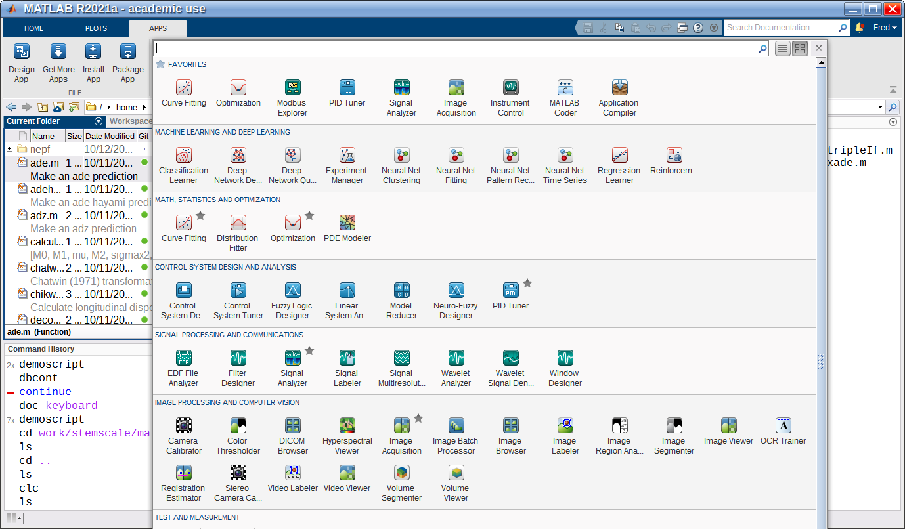
Other nice things
Basic GIT integration
Wide variety of toolboxes (and the MATLAB file exchange online)
Notes:
It’s also nifty, although I don’t use them much, that there is GIT integration and a large repository of toolboxes. The large number of first party built-in toolboxes is quite good and ensures compatibility.

Slide 9
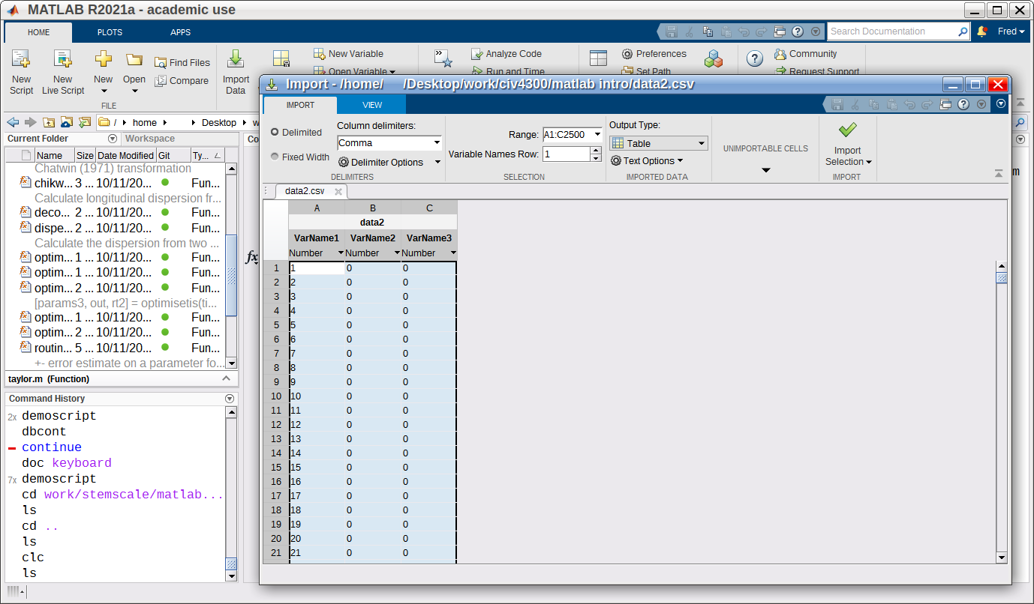
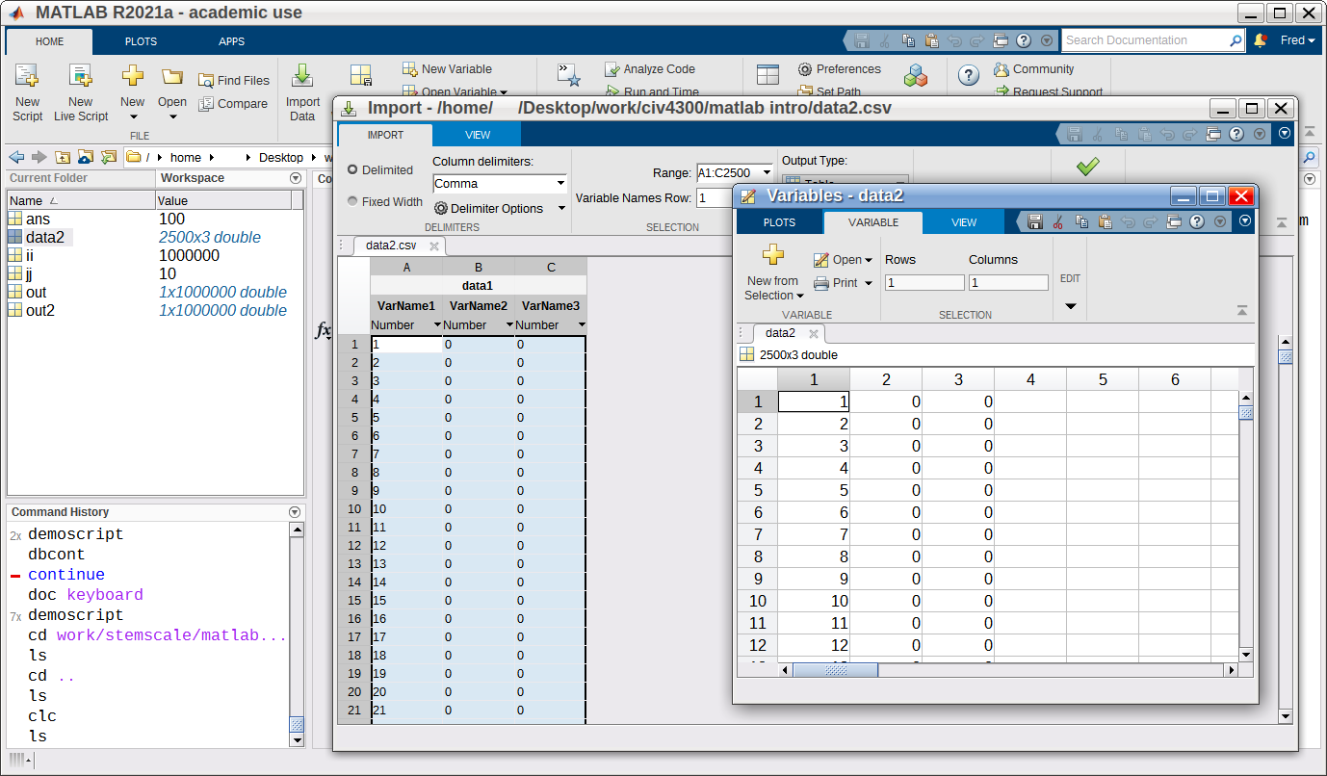
Data import
Data Import wizard
Imported data variable listed in workspace
Most variable types can be opened to directly edit them
I show this to students first to make using MATLAB a bit more approachable
Notes:
This is a useful way to import one-off data sets, and particularly I show this to students to make starting to use MATLAB more approachable.
I’ve also used the variable editor to fix one off malformed data by hand.

Slide 10
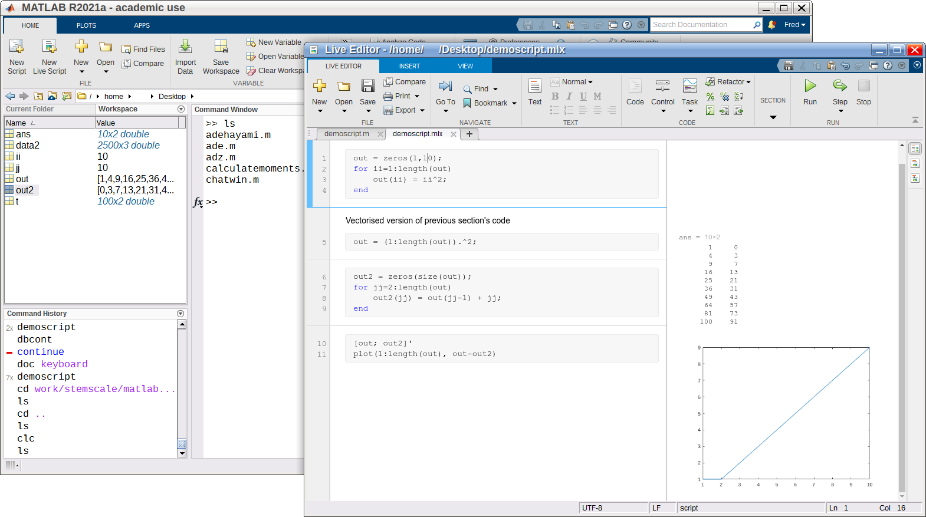
Live Scripts
This is a converted and edited version of previous demo script
Plain formatted text (and equations) in line with code
Output in same window and saved with script
A live script does pretty much everything a regular script does, including for debugging
Notes:
Live Scripts are basically a Jupyter notebook, including running within a browser window (embedded into the editor). Live Scripts are a more interactive way of working with the code, I generally recommend this to students, and I use it when I prepare worked solutions to tutorial sheets.
This has been a whistlestop tour of what I find to be the most useful features of the MATLAB IDE and the tight integration that I think keeps me from trying to migrate to Python.

